Slide 1
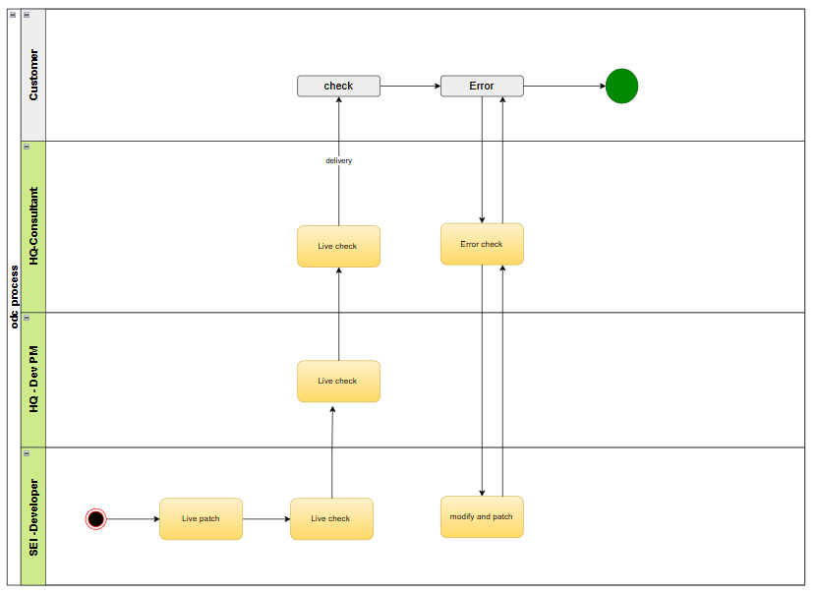

Customer
Contract
Development
Test
Education
Live
HandOver
Role PIC
Important !!!!!!
Confirm with customer and test together several times
2.Always stand by until the system stabilizes and respond quickly when an error occurs.

